Slide 1
A Real Time Application to Identify Alcoholics from ECG Signals
Akarsh N Kolekar (1PI13EC009) Guide: Dr. b Niranjana Krupa
Apoorv Vatsal (1PI13EC017)
Rakshith Vishwanatha (1PI13EC075)

Slide 2
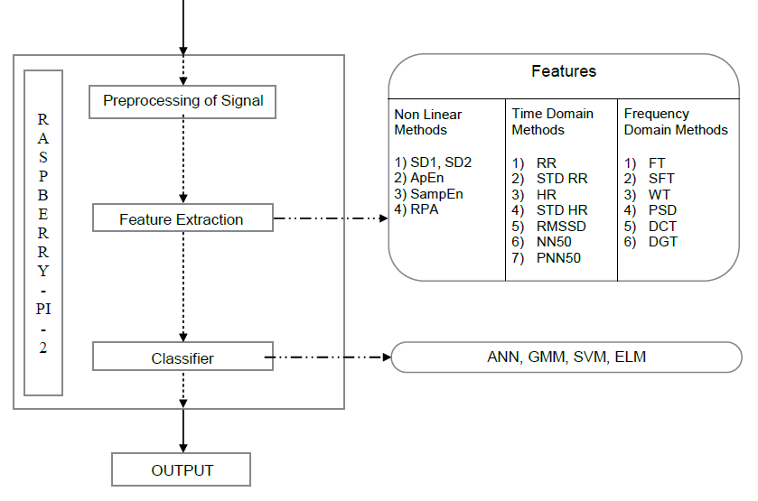
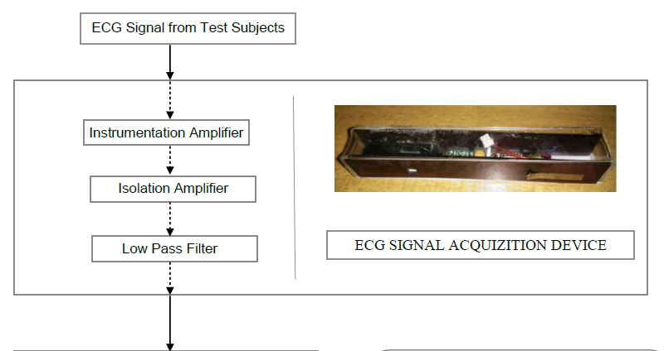
Overall Flow/Methodology

Slide 3
Work Done By The Last Review
RAKSHITH
Time domain feature extraction
Non linear feature extraction
APOORV
Raspberry pi setup
Frequency domain feature extraction
AKARSH
Circuit design/simulation
Introduction to ELM classifier

Slide 4
Work Done Since Last Review
RAKSHITH
Implemented SVM Classifier on MATLAB
Started Porting Code onto Python
Started work on Circuit and interface with Raspberry-Pi
APOORV
Converted all MATLAB toolbox operations to MATLAB scripts
Worked on AR Modelling. Started work on ARX.
Started work on Circuit and interface with Raspberry-Pi
AKARSH
Implemented ELM Classifier on MATLAB
Implemented ELM Classifier on Python
Started work on Circuit and interface with Raspberry-Pi

Slide 5
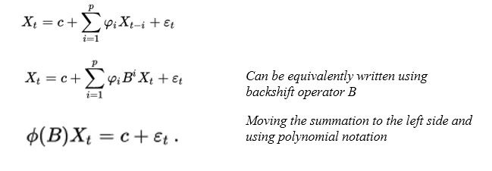
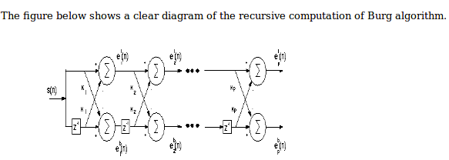
AR Modelling
Autoregressive Model is one in which a time series value is regressed on previous values
Burg’s Algorithm

Slide 6
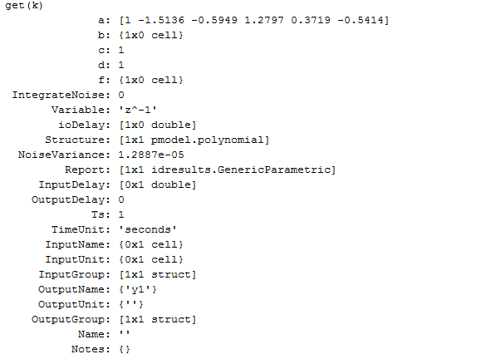
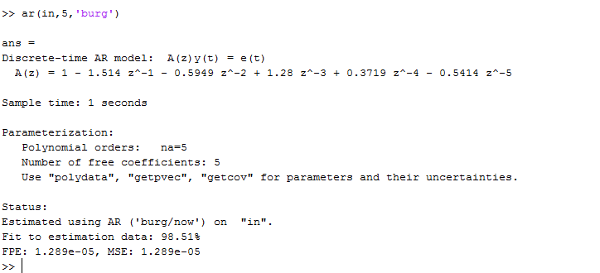
Implementation done so far

Slide 7
ELM
ELM Classifier was trained on MATLAB using 29 ALC and 29 NOR samples.
Hidden Layer: 500 Neurons, Activation Function: Sigmoid
Leave-One-Out Validation and K-fold Cross Validation (K=5) was done and average accuracy was obtained.
This was done 1000 times to find case where accuracy was highest.(~90% for Leave-One-Out and ~84% for K-fold Cross Validation)

Slide 8
ELM
The weights and biases for this case were saved to CSV files.
ELM Classifier was then implemented in Python using earlier obtained weights.
Classifier was tested using extended dataset.
Accuracy obtained was ~80% using first set of weights and ~70% for second set of weights.

Slide 9
Primary ELM Equations
Training
Testing
[Wi]: Input weights, generated randomly
[b]: Bias Matrix, generated randomly
[Xtrain]: Training Data
[Htemp_train]=[Wi]*[Xtrain]+[b]
[H]=activation_function(Htemp_train)
[T]: Targets of training data
[Wo]: Output weights
[Wo]=([H]⁺)*T’
[H⁺]: Moore-Penrose inverse of [H]
[Xtest]: Testing Data
[Htemp_test]=[Wi]*[Xtest]+[b]
[H]=activation_function(Htemp_test)
[Y]: Output
[Y]=([H]’)*[Wo]
Class testing data belongs to=index(max[Y])
Activation Function Used: Sigmoid
y=1/(1+exp(-x))

Slide 10
SVM
SVM Classifier was trained on MATLAB using 38 ALC and 29 NOR samples.
Regularization was used in the model to handle outliers.
RBF(Radial Basis Function)/Gaussian kernel was used.
SMO (Sequential Minimal Optimization) algorithm was used to obtain the Lagrangian multipliers and the KKT (Karush-Kuhn-Tucker) threshold.

Slide 11
SVM
K-fold Cross Validation (K=4) was done and average accuracy was obtained.
The support vectors and weights for the case yielding the maximum efficiency were saved to CSV files.
Accuracy of 98% was obtained.
Porting of code to python has been started.

Slide 12
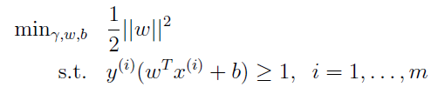



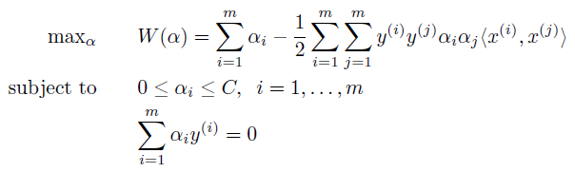




Primary SVM Equations

Slide 13
TARGETS FOR THE NEXT REVIEW
RAKSHITH
Perform Feature Reduction
Check if biasing occurs for SVM/ELM due to unequal training sample distribution
APOORV
ARX Modelling to provide more features for classification
Work on Sensor Circuit and Interface with Raspberry Pi
AKARSH
Explore Kernels(eg, RBF) for ELM
Look into Meta-cognitive learning algorithm for ELM Classifier

Slide 14
Literature Survey
G.-B. Huang, “What are Extreme Learning Machines? Filling the Gap between Frank Rosenblatt's Dream and John von Neumann's Puzzle,” Cognitive Computation, vol. 7, pp. 263-278, 2015.
Andrew Ng, “Support Vector Machines”, 2011. [Online] Available: http://cs229.stanford.edu/notes/cs229-notes3.pdf Accessed: 10-Feb-2016
Andrew Ng, “The Simplified SMO Algorithm”, 2012. [Online] Available: http://cs229.stanford.edu/materials/smo.pdf Accessed: 10-Feb-2016
Branislav Vuksanovic & Mustafa Alhamdi, “AR-based Method for ECG Classification and Patient Recognition,” International Journal of Biometrics and Bioinformatics (IJBB), vol. 7 ,Issue 2, 2013
Dingfei Ge, “Cardiac arrhythmia classification using autoregressive modelling”. [Online] Available: http://biomedical-engineering-online.biomedcentral.com/articles/10.1186/1475-925X-1-5

Slide 15
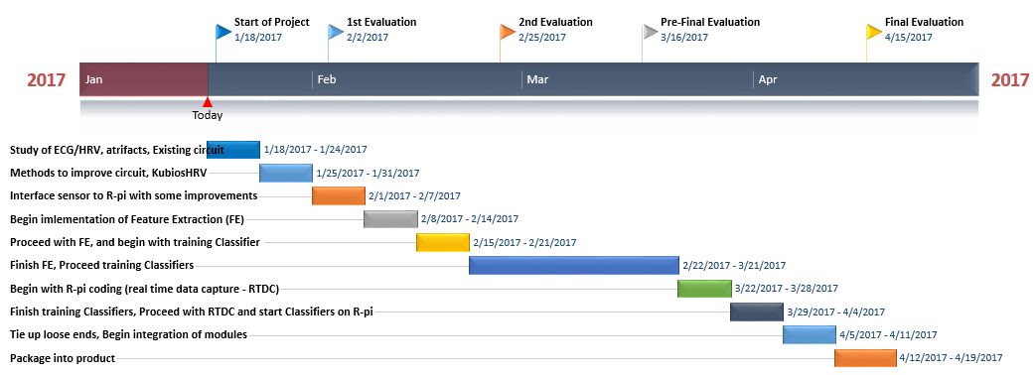
TIMELINE
On schedule as per expected timeline

